Slide 1

KONGU ENGINEERING COLLEGE PERUNDURAI – 638 060 JAVA MINI PROJECT:SIMPLE JAVA BUS INFORMATION SYSTEM Submitted by: Bharani dharan S(23EIR010). BHARANITHARAN T(23IR011). BHARATHI M(23EIR012).

Slide 2
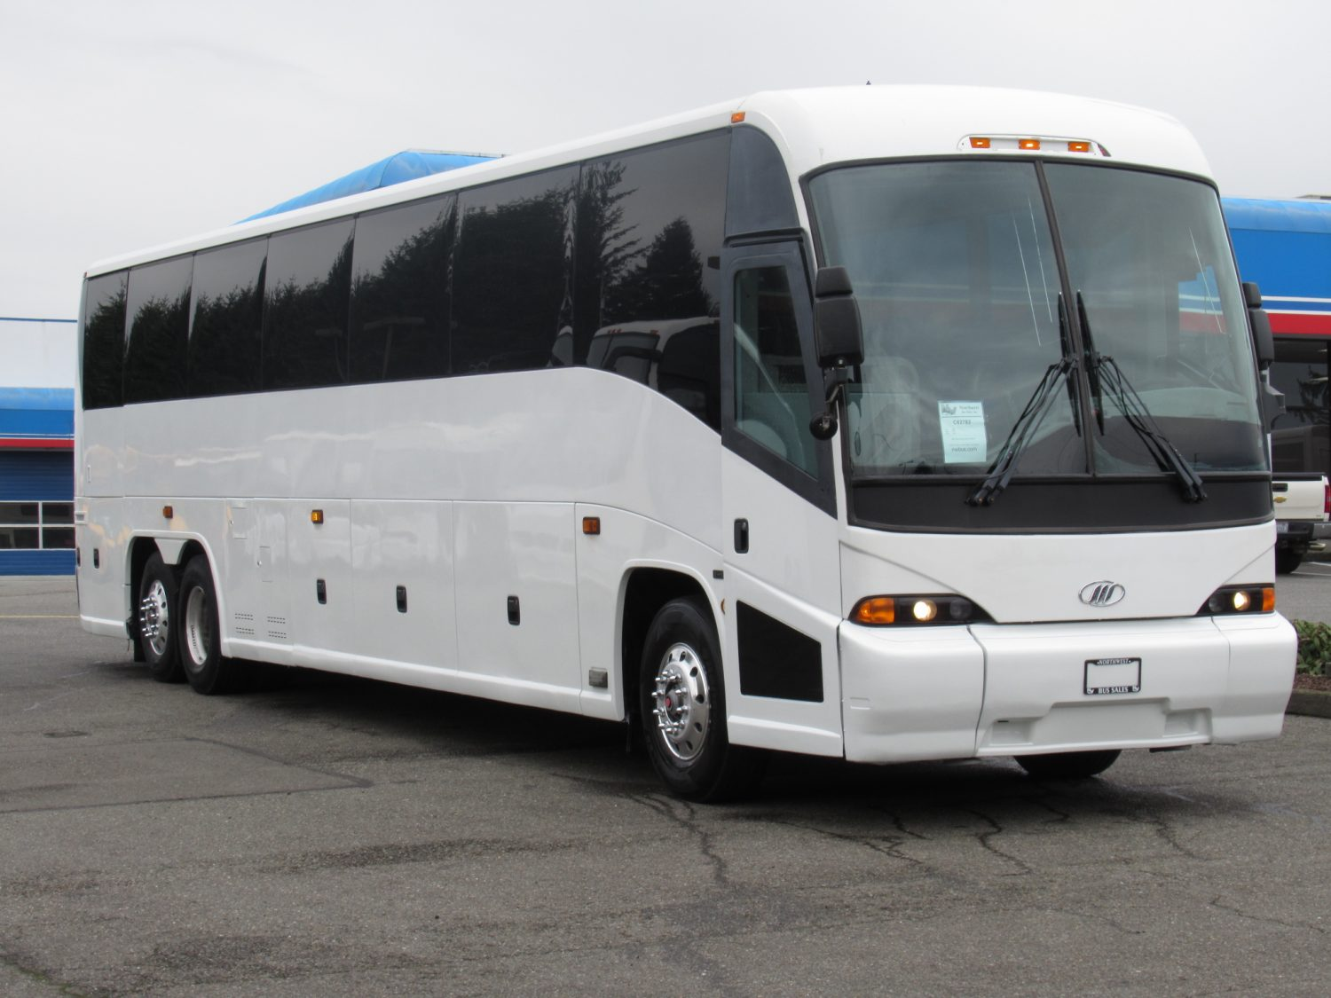
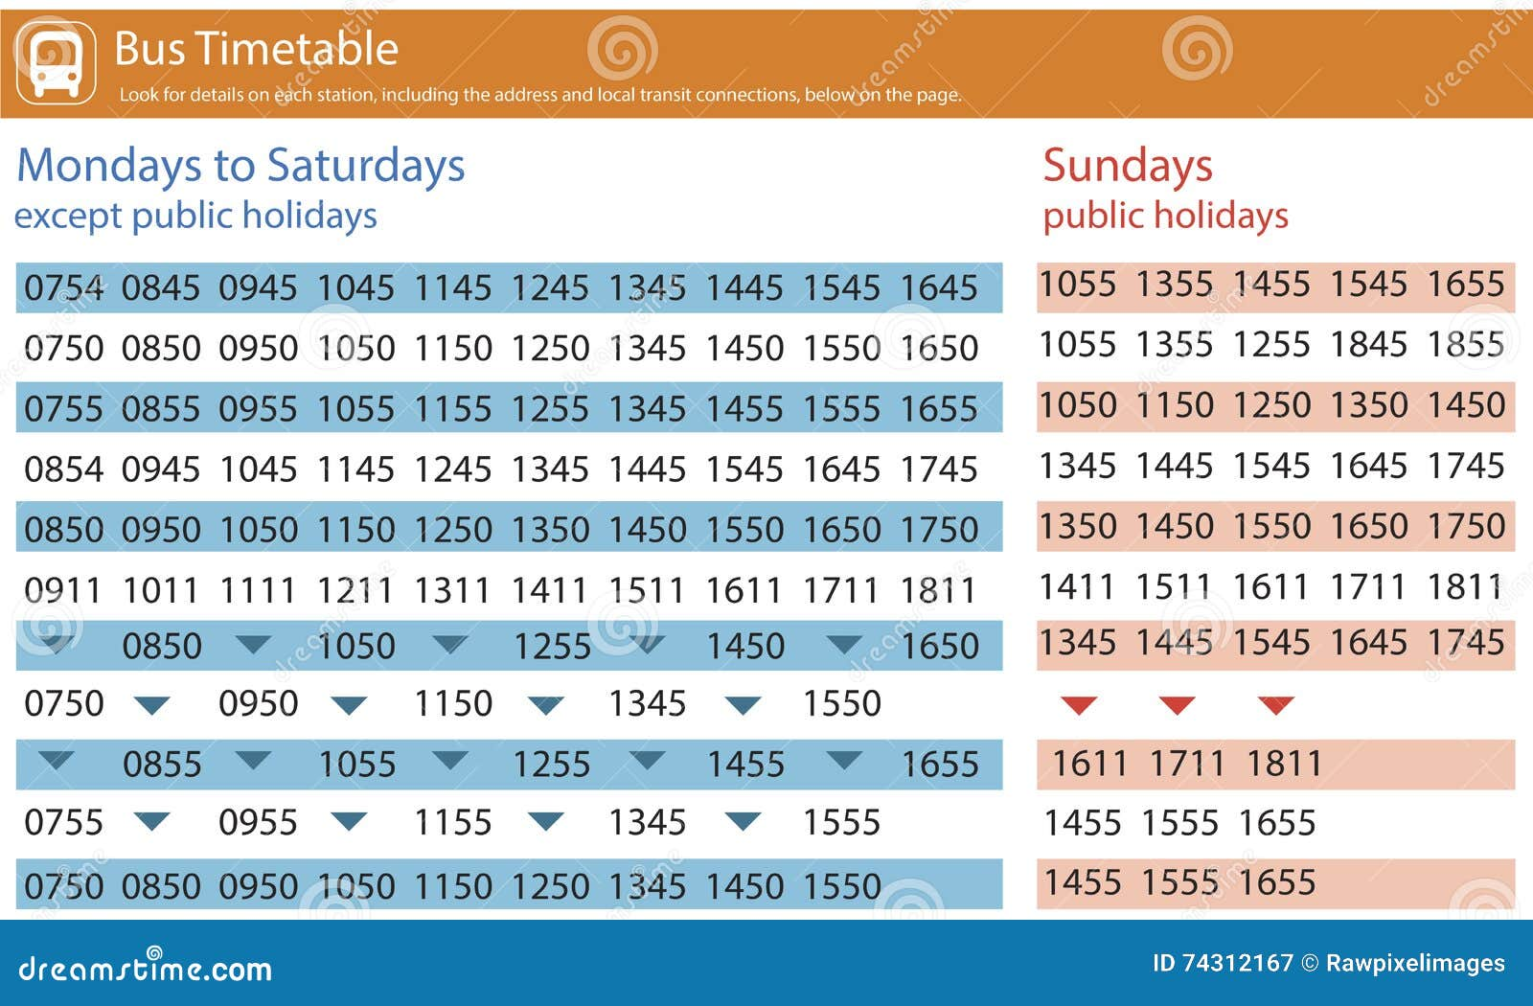
Objective of the project:
Primary Objectives
:1. Design and implement a simple Bus Information System using Java.
2. Store and manage bus records, including bus number, route name, arrival time, and departure time.
3. Provide functionality for adding, updating, and deleting bus records.Secondary Objectives.
4. Display bus records sorted by arrival or departure time.
5. Simple and robust operation of project.

Slide 3
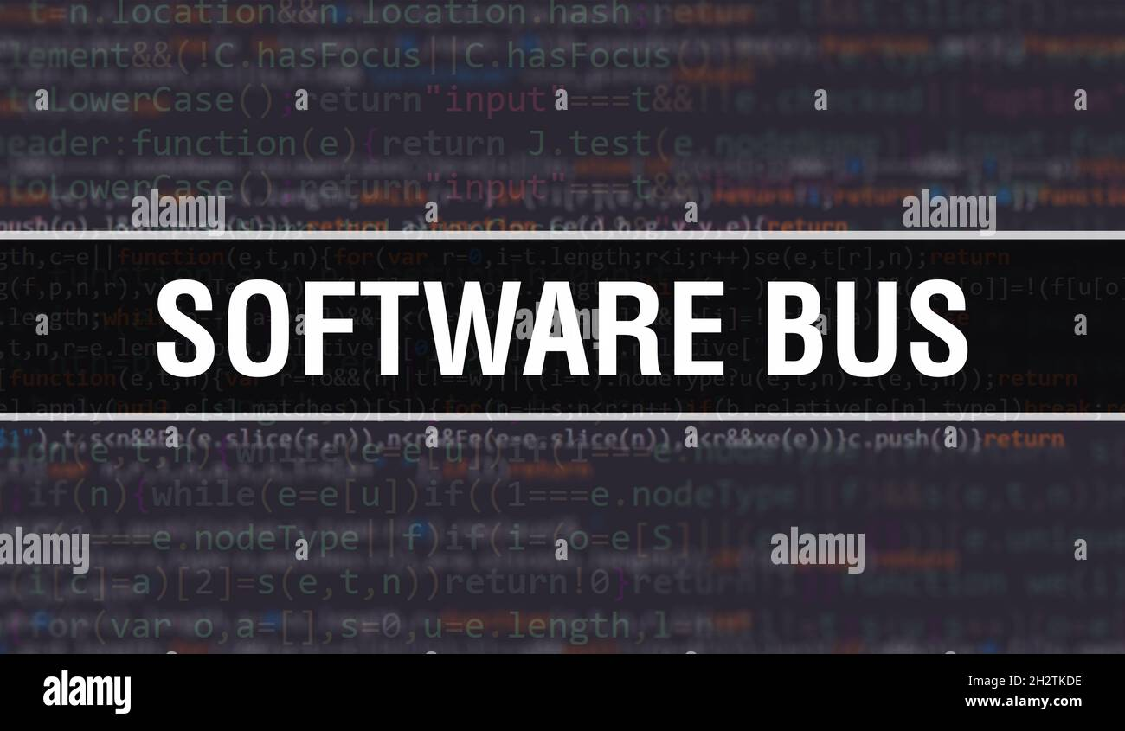
Problem Statement:
Create a 5 Bus Records with Bus number, Route Name, In time, out time
•Display the bus records based on out time ascending initially
•Get the Input from the User as route name or bus number
•Update the certain record it can be either bus number, route name , in time or out time
•New bus record added either last or first
•Delete the bus Record from the List.
•And, Display updated List
•Display the records either based on in time ascending descending or out time ascending based on user choice
Create variables of: private String[] bus Numbers, private String[] routes. And methods of
•public Bus Management System(); (Constructor)public void add Bus(String number, String route)public void update Route(String bus Number, String new Route) public void delete Bus(String number)public void display All Buses().

Slide 4
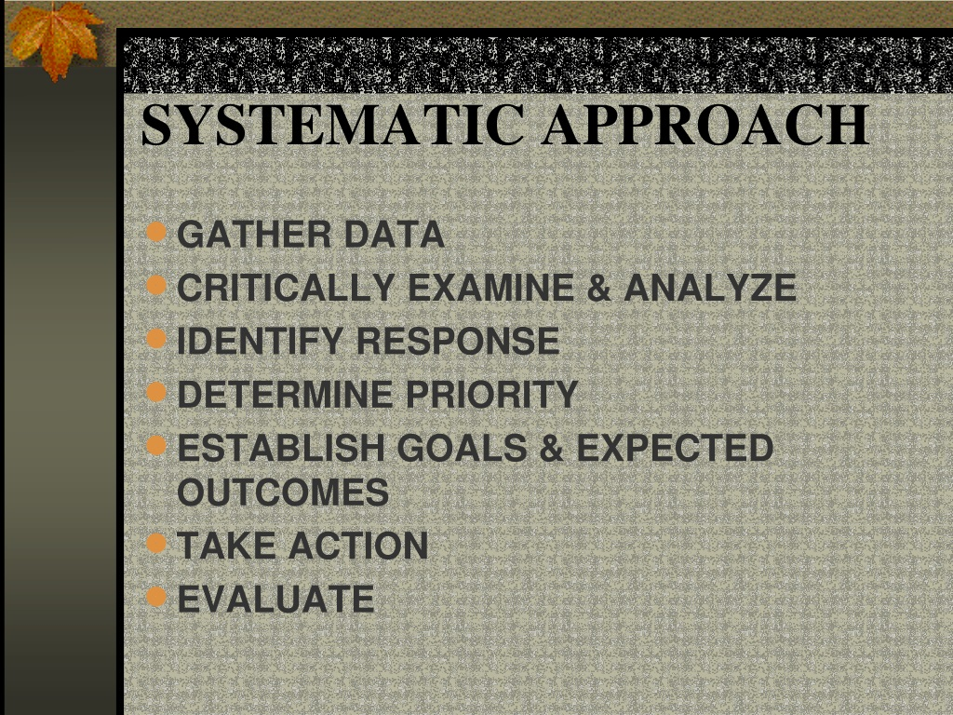
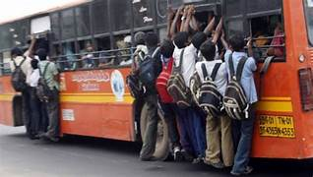

Problem background:
Public transportation systems play a vital role in urban mobility. Efficient management of bus operations is crucial for providing reliable services to commuters. Currently, manual methods are used to manage bus records, leading to inefficiencies and errors.

Slide 5


Methods and implementation of this program
Object-Oriented Programming (OOP): The code utilizes encapsulation (Bus class) and abstraction (Bus Management System class) to organize data and behavior.
Generics: The List interface and Comparator class leverage generics for type safety. Functional Programming: Java 8's Stream API and lambda expressions (buses . stream(), Comparator. comparing()) enable concise and expressive data processing.
Separation of Concerns: The code divides responsibilities between the Bus class (data model) and Bus Management System class (business logic). Command-Line Interface (CLI): The main method uses a Scanner to interact with users, demonstrating a simple CLI.
Data Sorting: The display Buses By Out Time and display Buses By In Time methods utilize Java's built-in sorting capabilities. Data Filtering: The delete Bus method employs Java 8's remove If method for efficient data removal.
Overall, this code showcases a well-structured, readable, and maintainable design.

Slide 6
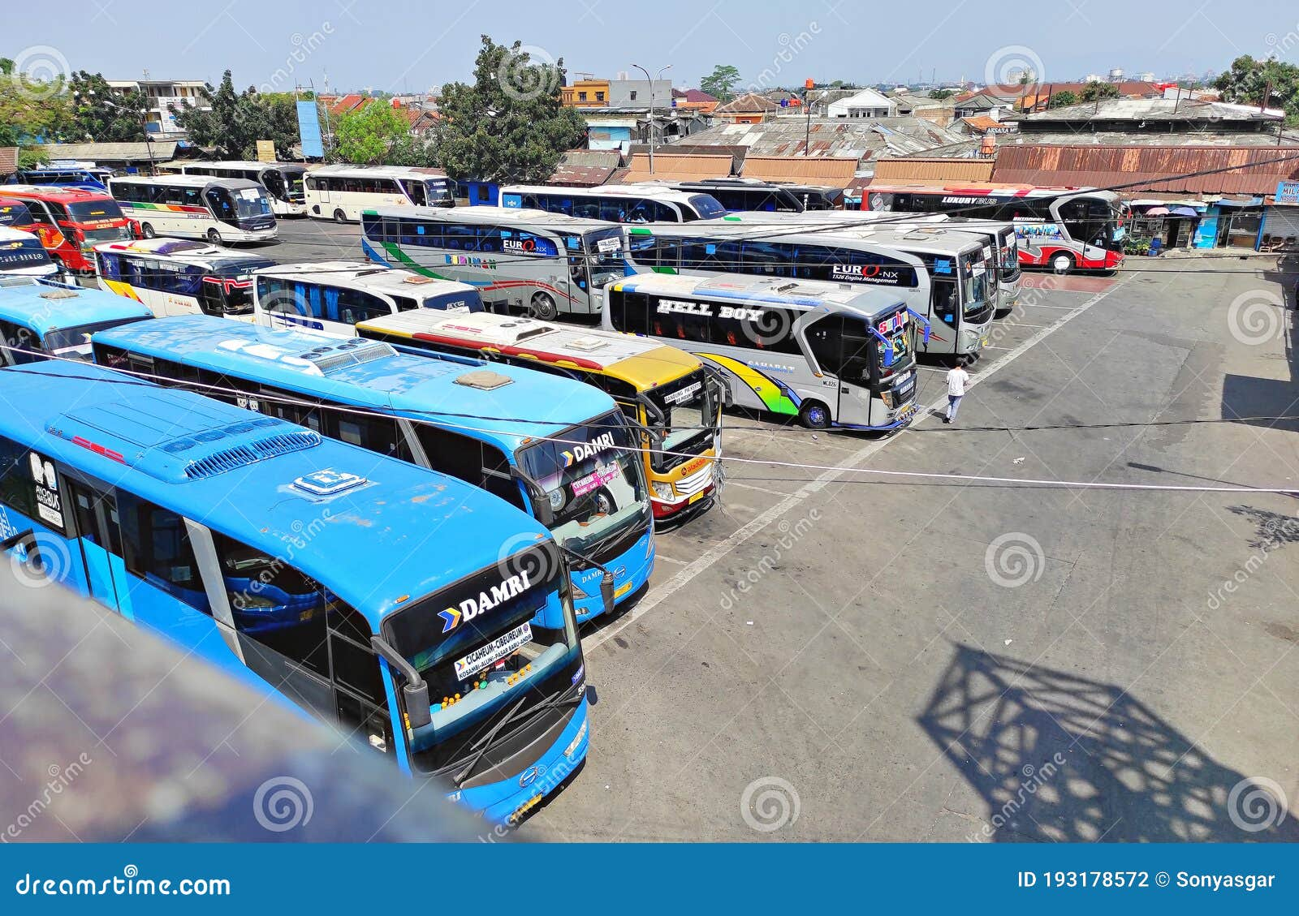
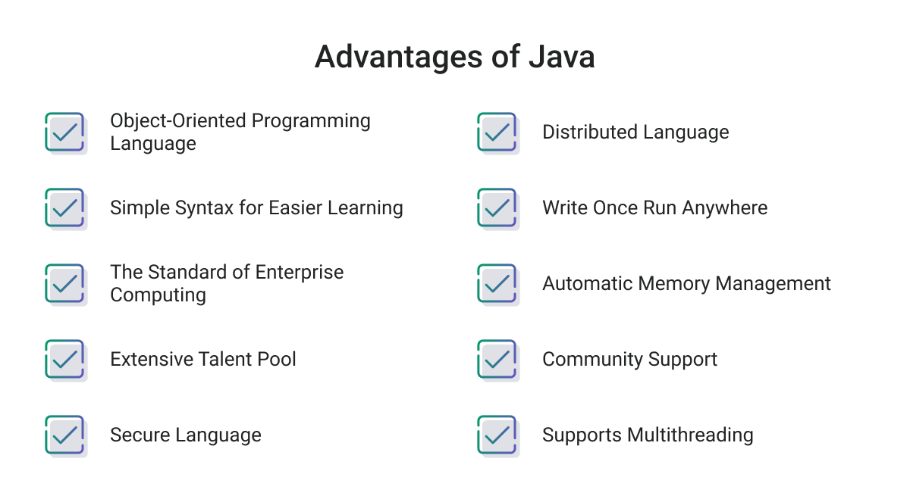
Advantages of this program:
Simple Execution.
Owner can easily change the bus based on their Requirement
Adoptable to different Conditions.
User can enter their unique bus name,and all other
Details.
5) Reliable and better safety.

Slide 7
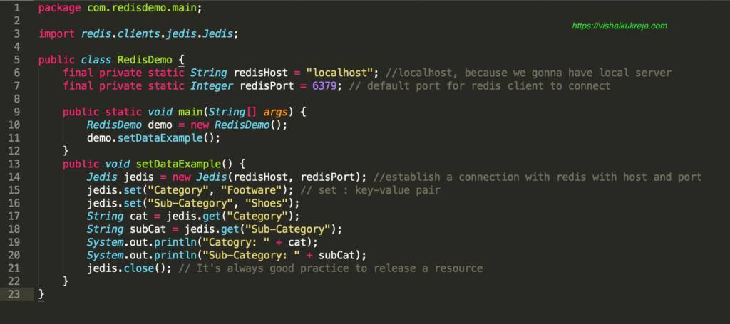
SAMPLE CODE: package practice18; import java.util.ArrayList; import java.util.Comparator; import java.util.List; import java.util.Scanner; public class BusManagementSystem { private List<Bus> buses; public BusManagementSystem() { buses = new ArrayList<>(); // Sample data buses.add(new Bus("101", "Route A", "08:00", "10:00")); buses.add(new Bus("102", "Route B", "09:00", "11:00")); buses.add(new Bus("103", "Route C", "07:30", "09:30")); buses.add(new Bus("104", "Route D", "10:00", "12:00")); buses.add(new Bus("105", "Route E", "06:30", "08:30")); } public void addBus(String number, String route, String inTime, String outTime) { buses.add(new Bus(number, route, inTime, outTime)); } public void updateRoute(String busNumber, String newRoute) { for (Bus bus : buses) { if (bus.getBusNumber().equals(busNumber)) { bus.setRoute(newRoute); break; } } }

Slide 8
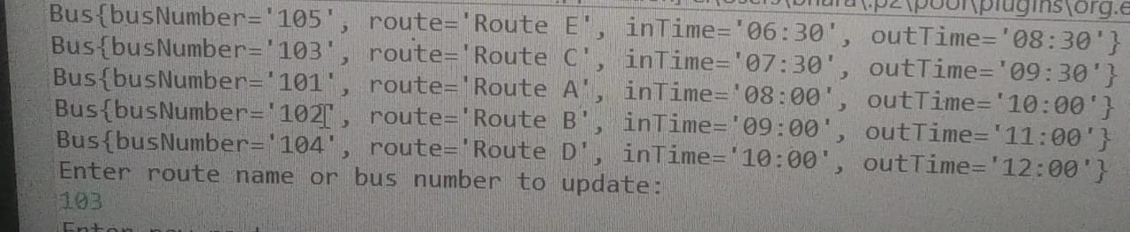
SAMPLE OUTPUT:

Slide 9
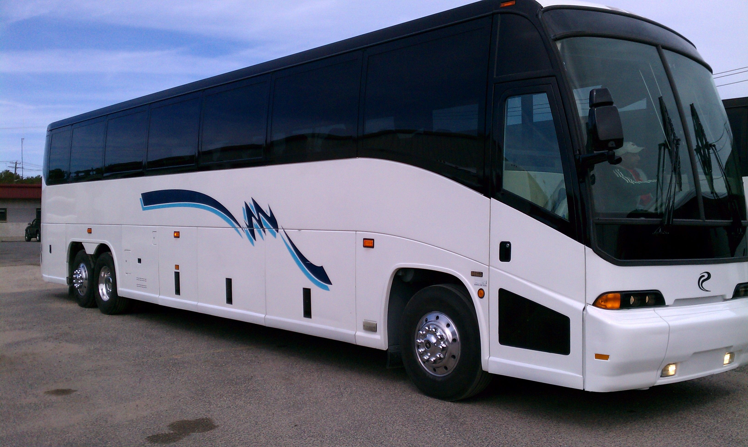
Conclusion: The Bus Management System effectively manages bus records, enabling efficient updates, deletions, and sorting. The system utilizes Java's Array List and Stream API for seamless data manipulation.Users can interact with the system through a command-line interface, updating routes and deleting buses. The code demonstrates object-oriented programming principles, ensuring organization and reusability.Overall, this system provides a robust foundation for managing bus information, facilitating streamlined transportation operations.

